Slide 1
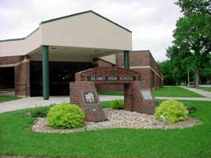
SENIOR CLASS FALL PRESENTATION

Slide 2
SENIOR YEAR EXPECTATIONS
One-on-one session with counselor (sign-up sheet)
Senior student status sheet
Post-Secondary Planning Day
ACT retake
ASVAB
Financial Aid/Scholarships
South Dakota Legislative Page Opportunity
SDSU Senior Day
Emails from Counselor
Campus Visit

Slide 3
ONE-ON-ONE SESSIONS
This is YOUR time reserved for your needs
Completed prior to Post-Secondary Planning Day
Review career plans
Review/research post-secondary plans
Complete admissions applications
Discuss ACT retake

Slide 4



STUDENT STATUS SHEET
Counselor collects/maintains info for progress
Post-secondary education
Military
Work
Monthly updates in classroom setting

Slide 5

POST-SECONDARY
PLANNING DAY
Admissions representatives/recruiters
All Juniors and Seniors attend (2 busses)
Huron Arena
Oct 1, 2012 (pds 5 – 8)
Admission rep/recruiter rep visits to DHS
(includes college coaches!!)
  Typically seniors
  Prior scheduling through counselor
  During student’s free time

Slide 6


ACT
Scores used for:
Post-secondary school admissions
Dakota Opportunity Scholarship
24+ with required classes
28+ without required classes
(begins with class of 2014)
Athletic eligibility
http://www.actstudent.org/
Test/registration dates
Test prep
On-line registration

Slide 7

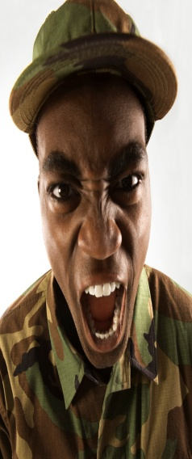
ASVAB
  Uses:
1. Military entrance & military aptitude determination.
      Branches each have different scores for entrance
      (may even depend on need at that time and students age)
      Aptitude for civilian occupations.
      No obligation to military. Recruiters can determine student’s qualification for opportunities.
  Juniors & Seniors (optional)
  Oct. 23, 2012 (pds 1 – 4)
  Military recruiters
      Will receive your scores
      May contact you. “NO means NO!”
      Schools are required to submit all students’ contact info unless you turned in form at registration. Copies still available from counselor.

Slide 8


FINANCIAL AID/SCHOLARSHIPS
Financial Aid
http://www.desmet.k12.sd.us/counselor/Financial_Aid.htm
Financial Aid Night for parents in late Jan or early Feb
Scholarships
http://www.desmet.k12.sd.us/counselor/scholarships.htm

Slide 9
SOUTH DAKOTA LEGISTLATIVE PAGE
OPPORTUNITY
Help legislators during session
Jan-Feb
No salary, per diem for lodging &meals
http://legis.state.sd.us/page/index.aspx

Slide 10

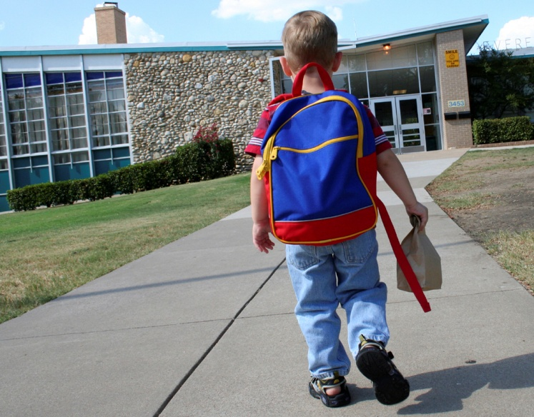
Campus Visit
Allowed two days to visit any campus
More Info

